Slide 1


Age and Car Insurance Rates
Jared Hubert, Francisco Lara Loza, William Thomer, Levi McLeod, Valerie Grannemann-Barber
Notes:
Our presentation is on Age and Car insurance rates

Slide 2
Do car insurance rates change with age?
Null: Car insurance rates change based on age range of mature drivers
Alternative (Hypothesis): Car insurance rates do not change based on age of mature drivers
Notes:
Does it get more expensive as you get older?
Does it go down as you get older?

Slide 3

Does age really matter??
Consumers pay what is charged for car insurance; there is no getting around it. It would be helpful to be knowledgeable about what and why we are being charged, and expectations for future rates and possibly why they change.
Notes:
Consumers pay what they are told and do not ask questions.
Some shop around to find cheaper rates, but not about what can change the rates

Slide 4
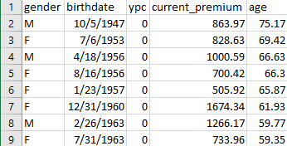
AllState Data-over 10,000 policy holders Lots of research from multiple car insurance and comparison rates sites Reading and interpreting common ground between sites. Arranged data by age range from given birthdates into bins.
Notes:
Our data set is from AllState with over 10,000 Policy Holders. The data has clear age ranges and premiums paid.
As a group, we researched several reputable websites and other car insurance sites.
We created our summary by interpreting common ground based on several sites.
We arranged the AllState data by age range birthdates into bins in our code.

Slide 5


Our code: Pandas, Bins, Male vs Female, Age group counts and percentages Outliers
Notes:
In our code: we imported pandas, used bins, count and percentages of Male vs Female, the difference age ranges counts & percentages, along with the premiums for each age group. And Outliers

Slide 6


Complication of our project:
The group question was originally too broad. We narrowed our question down based on Statistical Analysis.
Notes:
Complication of our project: The group question was originally too broad. We narrowed our question down based on Statistical Analysis.
We changed our question a couple of times before narrowing it down into something we were interested enough in to discuss and research.
????????There were more complications (more on that later)???????????

Slide 7
Myth: Car insurance rates decrease after 25th birthday. Fact: Best rates are from turning into a mature driver: other reasons Marital status, age, gender, years of driving experience and accident statistics normally are used to classify drivers
Average age of New drivers: 17-18 Average age of Retired drivers: 85+
Notes:
It is a myth that car insurance rates decrease after the 25th birthday.
The FACT is: the lower rates are based on becoming a mature driver. Most new drivers are around the age 17-18 years old.
But, there are many factors that can change the rates of car insurance premiums.
One happens to be the amount of years driving. And since the average age is 17-18, the average age for the rates to start to decrease is around the age of 25.
But, also marital status, credit scores, accidents, and traffic violations can change the Premium rates, and being male (more risky driver) or female.

Slide 8
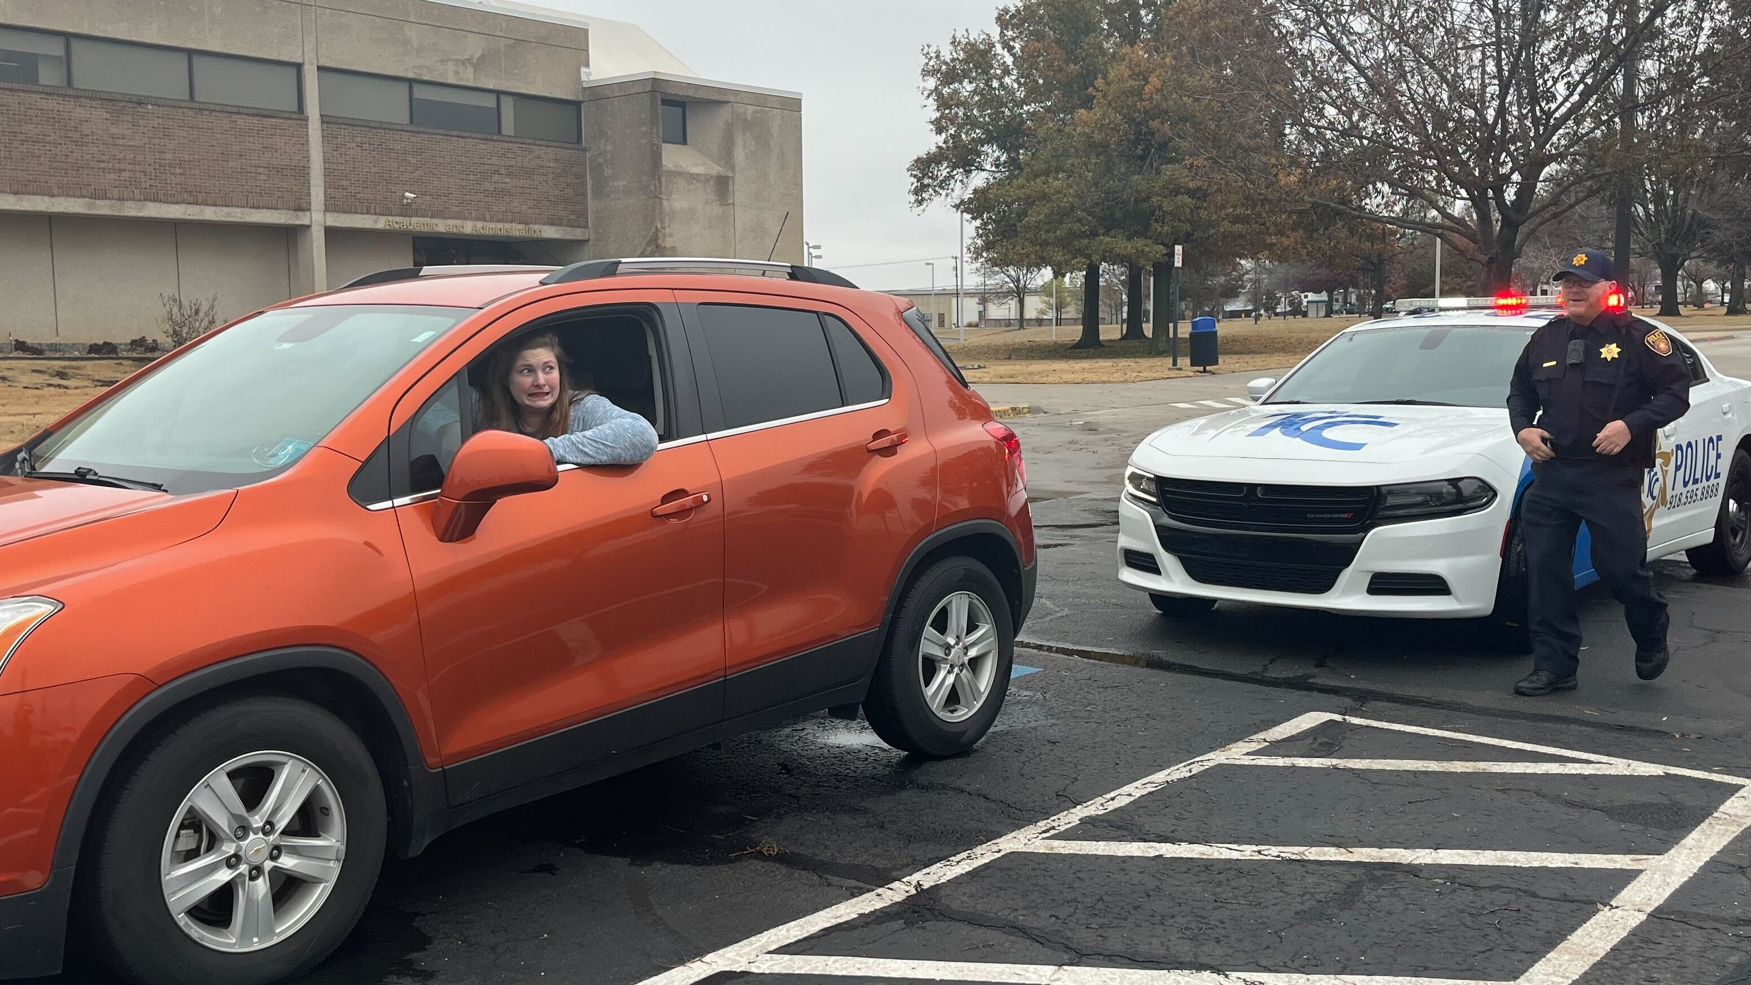
Statistics Persons with lower credit scores tend to have higher rates; lower credit scores tend to file more claims Many traffic violations, at-fault accident, will have increased rates. Men are involved in more traffic accidents, have serious traffic violations, and DUI’s: men’s rates will be higher. City vs rural, will have higher rates.
Notes:
The Statistics: Persons with lower credit scores tend to have higher rates; lower credit scores tend to file more claims Many traffic violations, at-fault accident, will have increased rates. Men are involved in more traffic accidents, have serious traffic violations, and DUI’s: men’s rates will be higher. City vs rural, will have higher rates.

Slide 9

It appears to be common knowledge that car insurance rates are at the highest in the teenage years.
Were you aware that they also rise after the age of 60? Rates don’t continue to decrease; they can also increase with age.
Notes:
It appears to be common knowledge that car insurance rates are at the highest in the teenage years.
Were you aware that they can also rise after the age of 60?

Slide 10
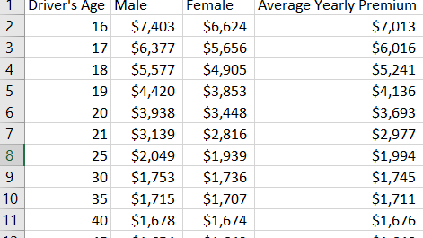
Average Premiums (according to ValuePenguin)
Notes:
Average Premiums based on age in this includes teenaged drivers.
Although our main dataset is on Mature drivers, we wanted to include teens as well to briefly explain WHY car insurance premiums change.
As you can see, on average, the Rates Start higher and decrease with age (or as you mature in your driving skills.
This also shows the difference between Male and Female driver’s premiums.

Slide 11
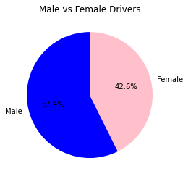
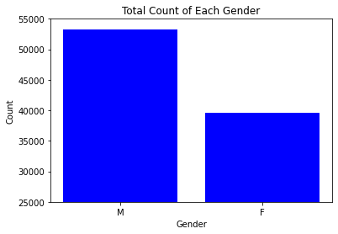
Male vs Female drivers in our dataset
Average Premium Male vs Female
Notes:
These are graphs from our dataset from AllState.
There are slightly more Male Policy Holders, and as you can see, the Premiums are larger. (because of their risky behavior)

Slide 12

Teenage drivers ages (16-19)
Rates are highest in the teen years.
Age 16-19 are 4x’s more likely to be in an accident
Found statistically less safe on the road in the first few years of driving
Rate of accident-related deaths per mile is 3x’s higher than 20 year olds
Greater tendency to speed
Not realize they are in a serious situation
(Car Insurance Rates & Age | DMV.ORG)
Notes:
I’ll briefly discuss a few statistics on Teenaged drivers
Rates are highest in the teen years.
Age 16-19 are 4x’s more likely to be in an accident
Found statistically less safe on the road in the first few years of driving
Rate of accident-related deaths per mile is 3x’s higher than 20 year olds
Greater tendency to speed
Not realize they are in a serious situation

Slide 13

Inexperience. Teens may not recognize or underestimate dangerous situations on the road. Nighttime and weekend driving. In 2019, 40% of fatal car crashes with teen drivers and passengers ages 13 to 19 were between 9 p.m. and 6 a.m. More than half (52%) of fatal car crashes happened on a weekend, according to IIHS. Not using seat belts. Teens and young adults tend not to wear their seatbelts as often. (45%) of teen drivers who died in 2019 were unbuckled, according to the National Highway Traffic Safety Administration (NHTSA). Speeding. In 2019, 27% of fatal car crashes involving teen drivers between ages 15 to 18 was due to speed, according to NHTSA
Notes:
Teens may not recognize or underestimate dangerous situations on the road.
40% of fatal car crashes among teen drivers and passengers ages 13 to 19 happened between 9 p.m. and 6 a.m. More than half (52%) of fatal car crashes happened on a Friday, Saturday or Sunday
Teens and young adults tend not to wear their seatbelts as often. Nearly half (45%) of teen drivers who died in 2019 were unbuckled
speed was a factor in 27% of fatal car crashes involving teen drivers between ages 15 to 18

Slide 14

Senior Drivers (60+)
According to DMV.ORG, As you reach age 65, you can expect your car insurance rates to start increasing. DMV.ORG analysis shows that a 75-year-old male driver pays 21% more for car insurance than a 55-year-old male driver. And once you hit your 80th birthday, there’s another spike in rates from age 75 (an average 9% increase for females and 12% for males)
Notes:
In our overall research, it was concluded, that around age 50, the rates are at the lowest. And at 65, to expect rates to start increasing.

Slide 15



Senior Drivers (60+)
Impaired vision.
Poorer cognitive functioning.
Changes in physical functioning, such as arthritis.
Use of prescription medications.
Older adults are likely to sustain more serious and costly injuries as the result of being in an accident.
(Car Insurance Rates & Age | DMV.ORG)
Notes:
There are several factors that contribute to rising insurance premiums.
Impaired vision, multiple medications/side effects, change in physical function, and increase healing time.
Older adults can sustain more severe injuries, costing more for the insurance company.

Slide 16
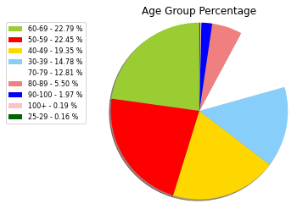
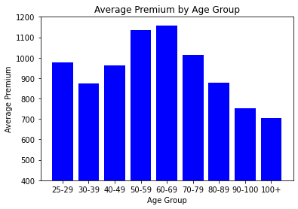
Age groups %
Average Premium by Age Group
Notes:
This is an example from our dataset of how we arranged our data in age groups: percentages and by premiums.
Our largest groups are age 40-49 and 50-59.
As you can see, according to our bar chart, the data is inconsistent with the research we just explained.

Slide 17
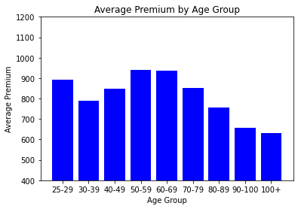
Notes:
Our data set shows that the 50-59 and 60-69 are the highest premiums.
Upon further investigation, we realized that our dataset is incomplete and missing data.
It shows that 50-59 has our highest premiums per Policy Holder, however, it does not express how many cars the Policy Holder owns, if they have teenagers on their policy, if there is bad credit involved/divorced, or wrecks on their record.

Slide 18
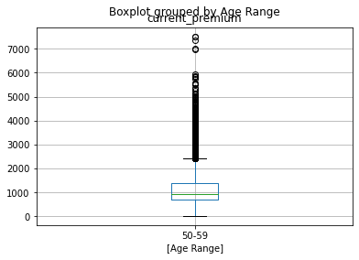
Notes:
We narrowed down our search in our 50-59 age range. This is where we realized that we have data on premiums per Policy Holder, but not how many cars are on the policy etc.

Slide 19
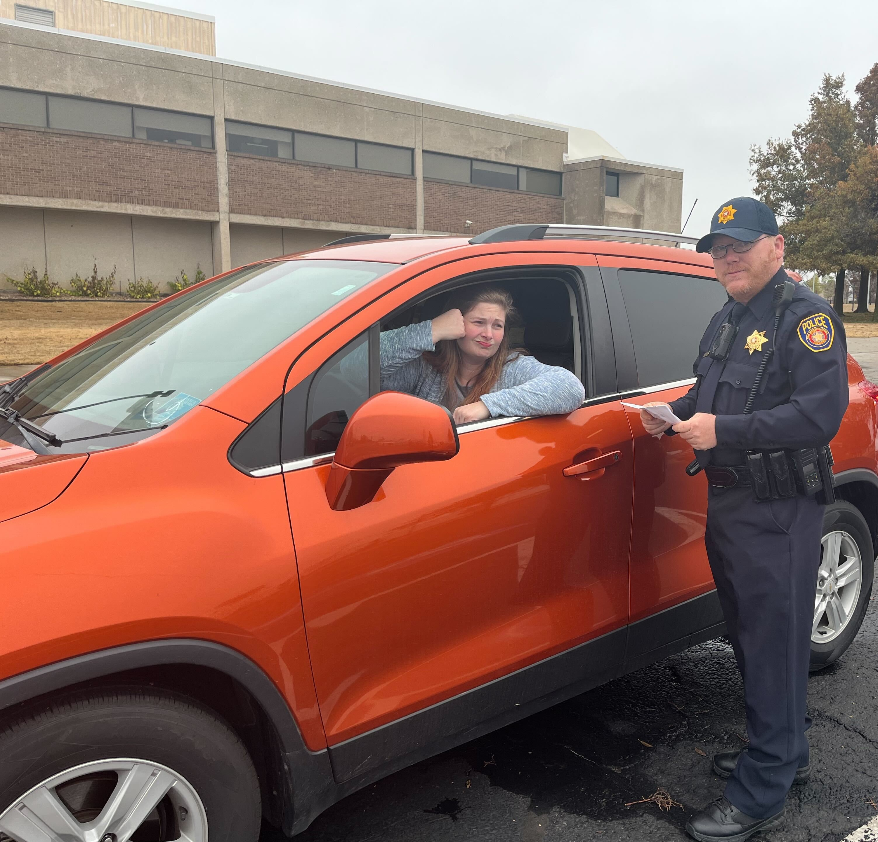
Null: Car insurance rates change based on age range of mature drivers Alternative (Hypothesis): Car insurance rates do not change based on age of mature drivers
The answer to our question is YES! However, many things play a factor into the rates and is not a clear cut answer
Notes:
Although we answered our original question, it was not the answer we anticipated based on our research.
The answer to our question is YES! However, many things play a factor into the rates and is not a clear cut answer
It is evident that our dataset is incomplete, or needs more information in order to create a fair assessment.
We concluded that more data needs to be collected to create an accurate record.

